Slide 1
Workshop1
Alyph Collection
(Boutique Management System)
Muhammad Putra Alif bin Ismail
B031910115

Slide 2
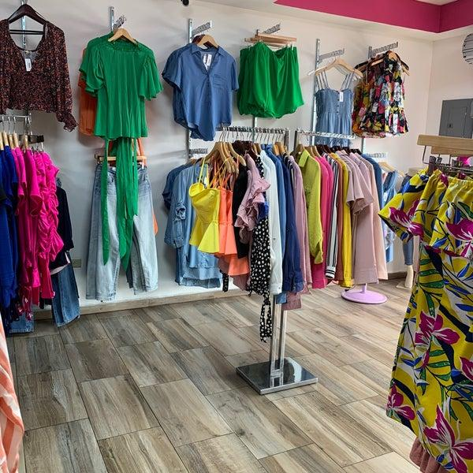
About
The name of this project is Alyph Collection. It is a management system of a boutique that sells various kinds of goods and most of them are clothing. This project aimed to improve the services of a boutique including billing, making sale report, buying goods, update stock and etc. This project will surely make a management of a boutique become seamless and efficient.

Slide 3
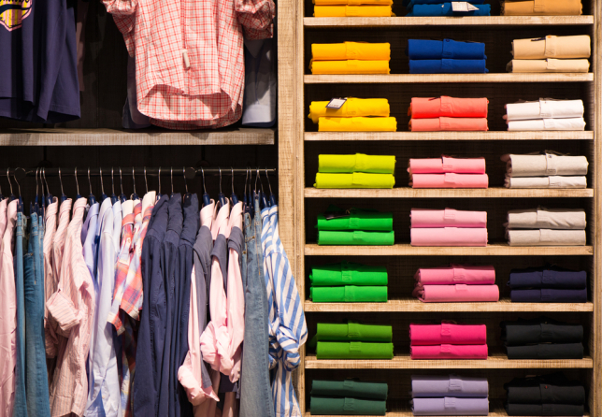
Problem Statement
Although nowadays is a modern day, there are still some businesses including boutique that use an old school approach to keep track of their business. It is very inefficient because the old school approach will make:
- Searching for available stocks is very difficult; takes time
- Stocks are not well organized
- Order may be skipped/unnoticed

Slide 4
Objective
· To design and develop a system to help business such as boutique
· To assess in managing stocks in the inventory, order and sale report
· To make recommendations on improving management services

Slide 5
Module to be Developed
Access Module
Inventory Stock Module
Order Module
Sale Report Module

Slide 6
Access Module
Staff can:
Register
Login
Update Password
Update Phone Number

Slide 7
Inventory Stock Module
Staff can:
View existing goods in list
Add new goods
Delete existing goods
Update goods stock

Slide 8
Order Module
Staff can:
Search receipt number
Customer can:
Search goods by name
Buy multiple goods
View order
Delete order
Cancel order
System will:
Give receipt after order

Slide 9
Sale Report Module
Staff can:
View sale record
View sale by goods ID
View sale by goods name
View sale by highest goods sold
View sale by date

Slide 10
Target User
Boutique
Personal/individual clothing business

Slide 11
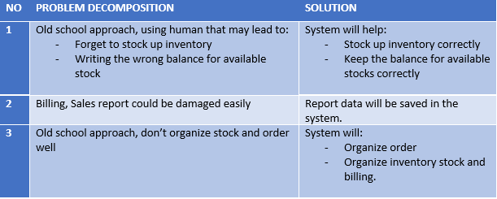
Problem Decomposition

Slide 12
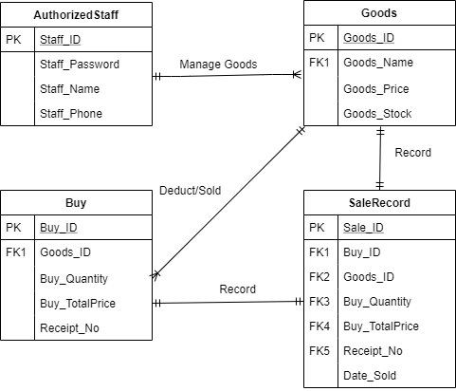
Entity Relationship Diagram

